Slide 1
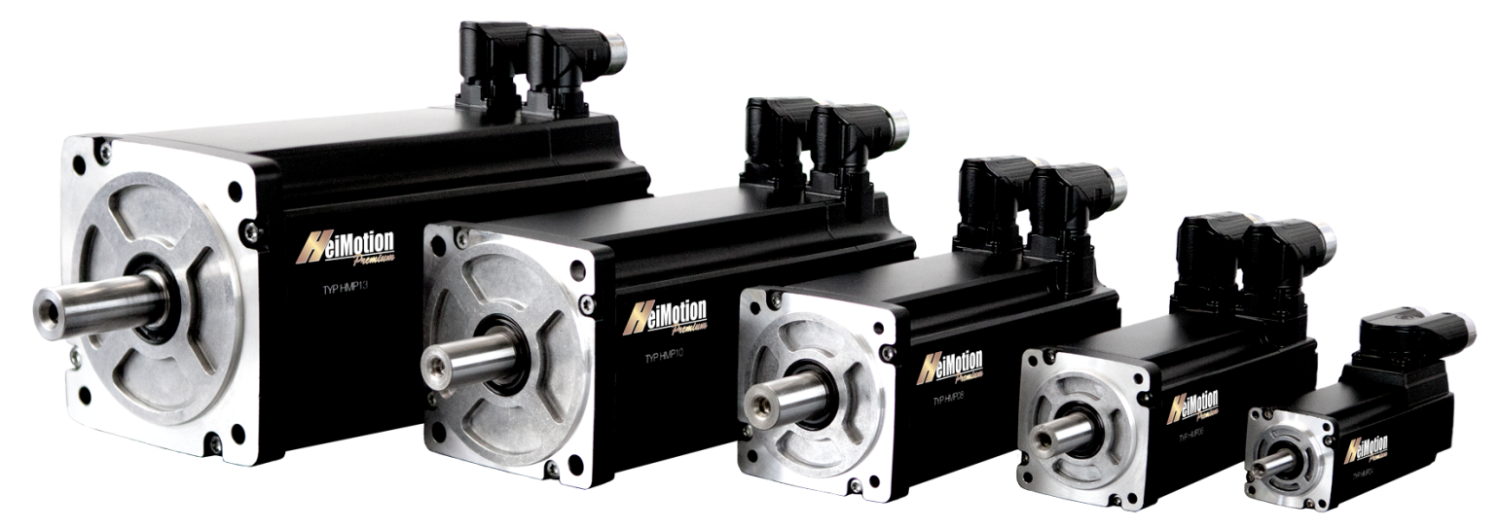
HeiMotion servo motors

Slide 2
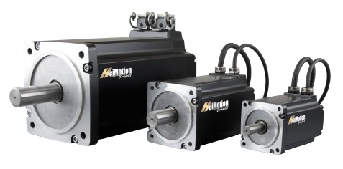
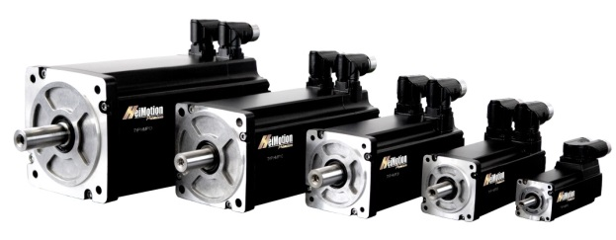
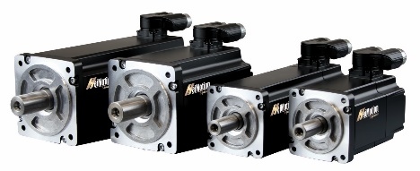
HeiMotion servo motors
1 modular platform -- 3 motor ranges -- Million solutions

Slide 3
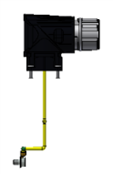
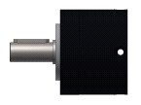
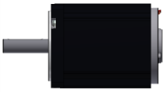
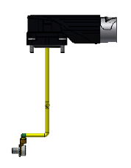
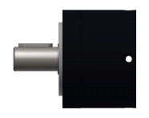
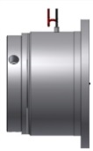
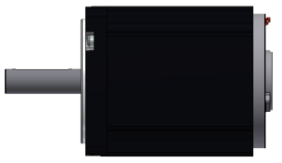
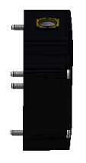
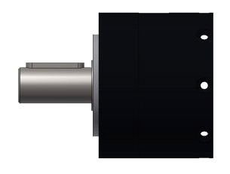
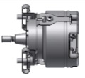
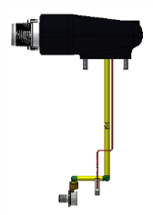
The modular servo platform of
With our modular platform concept we offer unique standardized product ranges
feather key &
radial oil seal
planetary gear boxes
brake
motor
encoder
caps
connectors
More than 30 million variations possible

Slide 4
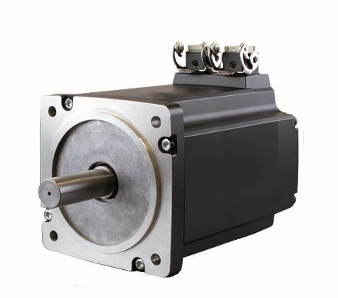
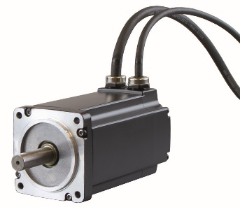
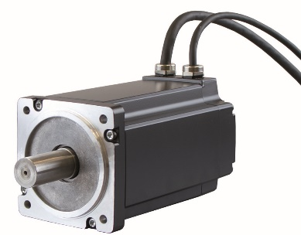
HMC - range
HMC06
2 stack lengths
U_{Bus} = 320V DC
M_{O} = 0.7 – 1.5 Nm
n_{rated} = 3,000 rpm
HMC08
2 stack lengths
U_{Bus}= 320/560V DC
M_{O}= 2.8 – 3.5 Nm
n_{rated} = 3,000 rpm
HMC13
4 stack lengths
U_{Bus}= 320/560V DC
M_{O}= 5.5 – 18.5 Nm
n_{rated} = 2,000 rpm

Slide 5
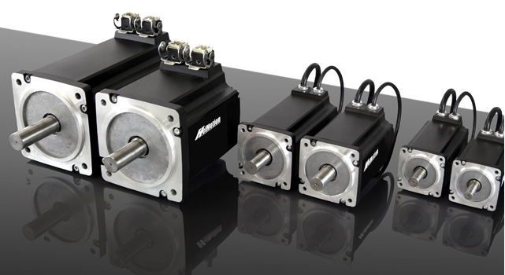
HMC – characteritics
all motors with overlapped winding technology
6-pole structure of the machines
Mounting dimensions are compatible to Mitsubishi, SanyoDenki and Panasonic
Very compact design
IEC and CE conform
Low cogging torque
Limited voltage, speed and power levels
Limited encoder availability
HMC06, HMC08 with 0.5m cable is standard; HMC13 with connectors
No other connector types available
No vacuum encapsulation
Higher moment of inertia compared to HMD
No UL certification and KTY
Design for high batch sizes
No deeper applications
Cost efficient servo motors
No oil seal (only 2RS bearings)
Evaluation in the controller via I²t

Slide 6
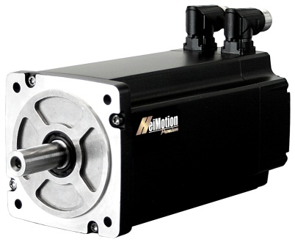
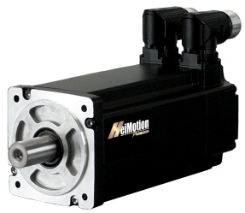
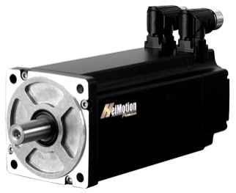
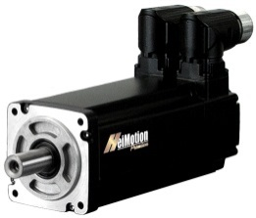
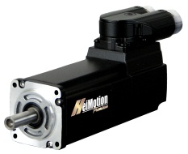
HMP - range
HMP04
2 stack lengths
U_{Bus}= 48/320V DC
M_{O}= 0.18 – 0.35 Nm
n_{rated} = 3,000 rpm
6,000 rpm
9,000 rpm
HMP06
2 stack lengths
U_{Bus}= 320V DC
M_{O}= 0.7 - 1.5 Nm
n_{rated} = 3,000 rpm
6,000 rpm
HMP08
2 stack lengths
U_{Bus}= 320/560V DC
M_{O}= 2.8 – 3.5 Nm
n_{rated} = 3,000 rpm
5,500 rpm
HMP10
2 stack lengths
U_{Bus}= 560V DC
M_{O}= 5.6 – 7.5 Nm
n_{rated} = 3,000 rpm
5,000 rpm
HMP13
4 stack lengths
U_{Bus}= 320/560V DC
M_{O}= 5.5 – 18.5 Nm
n_{rated} = 2,000 rpm
3,600 rpm

Slide 7
HMP – characteristics
all motors with overlapped winding technology
6-pole structure of the machines (4-pole at HMP04)
Finely graded power levels in the power range up to 4 kW
Different rated speeds available
No vacuum encapsulation
Very compact design, high power density
Optimized inertia (medium to higher values)
Very low cogging and torque ripple
Speed up to 9,000 rpm is standard
cURus recognition
All motors with UL isolation
Protection class up to IP65
KTY for temperature measurement
Large variety of encoders and connectors
Smooth shaft with axial thread
Customized designs possible
Designed for different batch sizes
Slight modifications possible

Slide 8
HMP19 - properties
Upward extension of the existing HMP-series
Max. nominal speed 3,000 rpm
Nominal power up to 15 kW
Stall torque up to 110 Nm
Compact design
Brake version up to 115 Nm static braking torque
Increasing of the encoder variance to EnDat 2.2
CURus-complete certification
M40 power connector
Optimized inertia

Slide 9
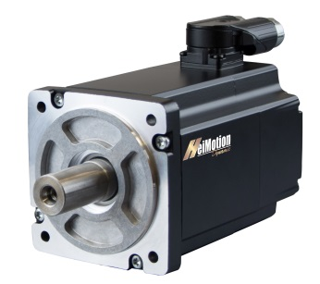
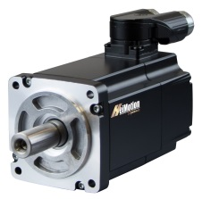
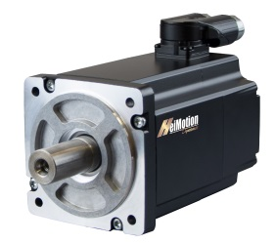
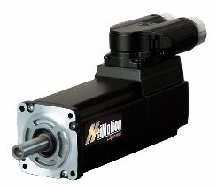
HMD - range
HMD04
3 stack lengths
U_{Bus}= 24/48/ 320/560 V DC
M_{O}= 0.2 – 0.5 Nm
n_{rated} = 3,000 rpm
6,000 rpm
9,000 rpm
HMD06
4 stack lengths
U_{Bus}= 24/48/ 320/560 V DC
M_{O}= 0.5 – 2.0 Nm
n_{rated} = 3,000 rpm
6,000 rpm
HMD08
5 stack lengths
U_{Bus}= 24/48/ 320/560V DC
M_{O}= 2.0 – 6.0 Nm
n_{rated} = 3,000 rpm
5,500 rpm
HMD10
3 stack lengths
U_{Bus}= 24/48/ 320/560 V DC
M_{O}= 5.0 – 10.0 Nm
n_{rated} = 3,000 rpm 5,000 rpm

Slide 10
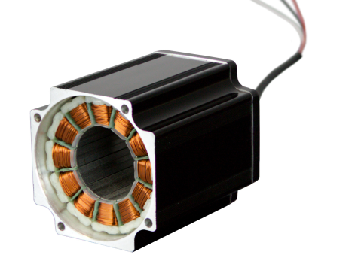
HMD - characteristics
HMD Series
Concentrated winding technology with high efficiency
Extremely compact (reduction of the coil heads and package height)
Utilization of many parts of the HMP series (flanges, encoders, ec.)
Fully configured via the SAP module
General properties of HMD combined to HMP
Highly dynamic motors with minimum inertia
Good torque quality for concentrated motor design (ripple at n_{rated} ~ 1,5%)
Finer performance grading as HMP
(500W – motor as HMD06 and HMD08)
Very high slot fill ratio (higher efficiency)
Overload capability reduced (M_{max} = 2.5xM₀)
Among 230V/400V - also 24/48V - and 480V – windings
(low voltage and US market)
Optimized thermal and electrical properties by full potting technology (dU/dt > 14kV/µs)

Slide 11
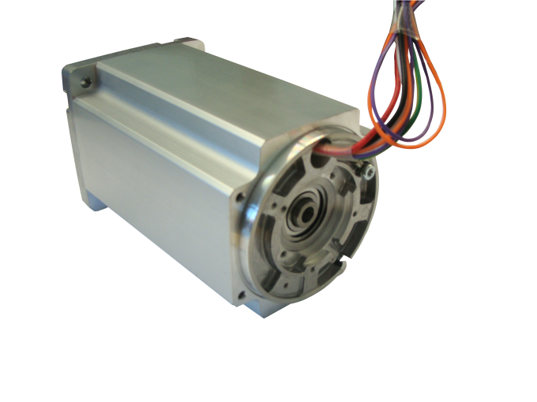
Selling proposition - bearing
Bearing system and optimized installation:
All motors built up with one solid and one floating bearing
Floating bearing set into a steel bushing to avoid noise even at high temperatures
Integrated compensation of tolerances and thermal expansions
Very high axial and radial forces tolerable
High temperature grease and optimized bearing clearance for maximum life time
Distance between shaft end and encoder location is exactly mounted by ± 0,05mm
Lowest possible series deviation for this important measure
Encoder exactness is valid for the whole temperature range
Notes:
Not every selling propositions may be unique
But factors pointed out here are not ordinary for every servo motor
HMC selling propositions are also valid for the HMP / HMD and HMPG programs

Slide 12
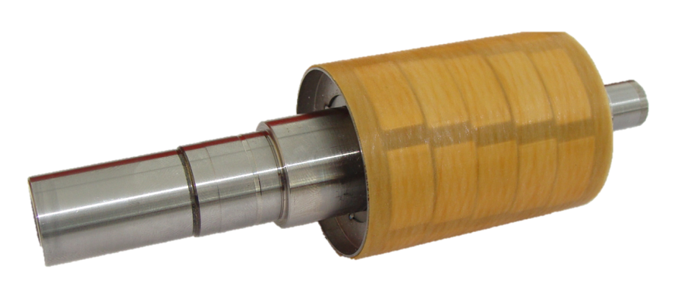
Selling proposition - rotor
Magnet rotor with bandage:
Optimized skewing angle for minimal cogging
Bushing made of sheet metal for minimal losses
Balancing up to Q1
Fiberglass bandage
=> No loose and injuring of magnets

Slide 13
Selling proposition – winding
Various winding technologies
Manufactured in own winding center in the Czech Republic
Extremely compact winding heads
Integrated temperature control with KTY84-130 (HMP and HMD)
4-fold overload capacity at HMP
2,5-fold overload capacity at HMD
High efficiency up to 94%
Electrical time constant HMD > HMP = Better controllability
Surge voltage durability of > 8kV/µs (HMP) and 14kV/µs (HMD)
100% of the produced coils are tested with a voltage steepness of 8kV/µs
No partial discharges and short circuits in series products
Up to 15m cables no problems occur

Slide 14
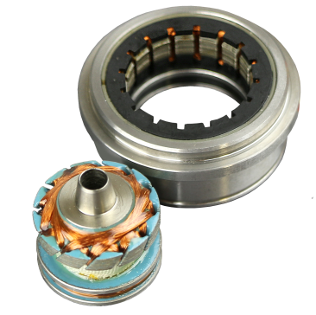
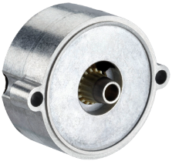
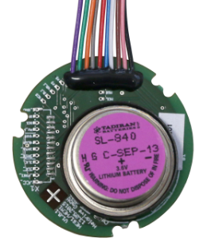
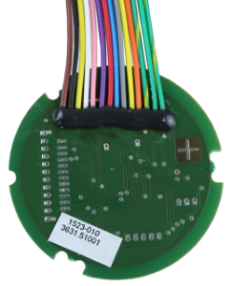
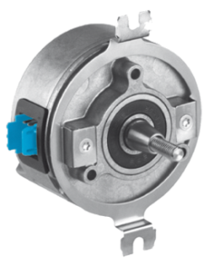
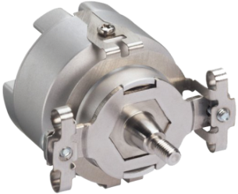
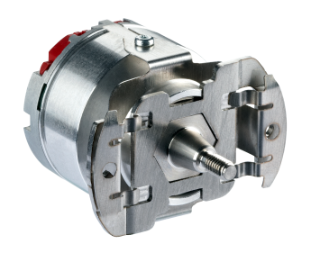
Selling proposition - encoder
Resolver (standard)
Sine/cosine tracks
Inductive system
Resolution up to 12 bit
Absolute value encoder SEK/SEL 37
16 sine/cosine periods per rotation
Absolute position with a resolution of 512 steps per rotation
Measuring of 4,096 rotations (multi-turn)
Hall encoder HES/HEM
SSI Interface
Single-/multiturn encoder
Resolution up to 14 bit
Output of commutation signals
Hiperface encoder SKS/M 36 & SRS/M 50
Up to 1,024 sine/cosine periods per rotation
Absolute position with a resolution of up to 32,768 steps per rotation
Measuring of 4,096 rotations (multi-turn)
Incremental encoder CKS 36
Resolution up to 2,048 pulses per revolution
Number of pole pairs from 1 to 32
Free programmable
Index pulse 90° or 180°
Hiperface DSL encoder EKS/M 36 & EFS/M 50
Absolute position with a resolution of up to 8,388,608 steps per rotation
Measuring of 4,096 rotations (multi-turn)

Slide 15
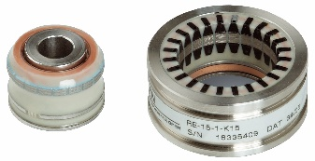
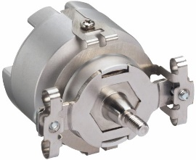
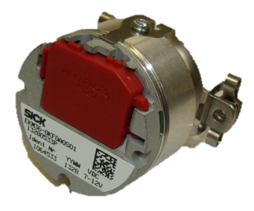
Selling proposition - encoder
Secure encoder fixture (SIL2):
Expansion of the HMP-series with safely attached encoders
Elimination of errors due to:
sufficiently dimensioned shaft- and case connection (20-fold overload)
documented installation torque to the series number of the servo motor
Safety integrity level of category 2 (SIL 2/PL d)
Encoder types:
Hiperface-encoder SKx36S
Hiperface DSL-encoder EKx36-2
Resolver

Slide 16
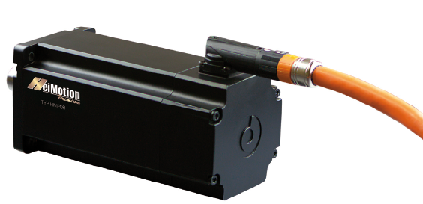
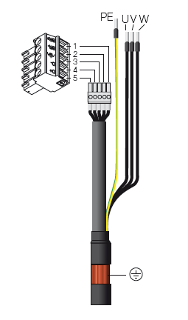
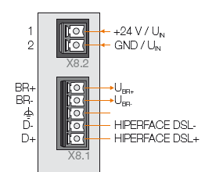
Selling proposition – Hiperface DSL
Properties
Only one cable for signal and power
Hiperface DSL-encoder EKx36
Optical encoder with 128 sin/cos per revolution
Motor temperature sensor is connected with the encoder
Reduction of cabling demand/ cable carrier
Uniform digital interface
Useable from HMP06 to HMP13 (HMP19)

Slide 17
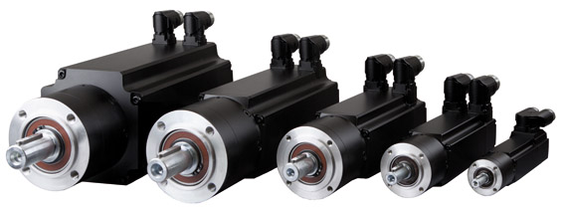
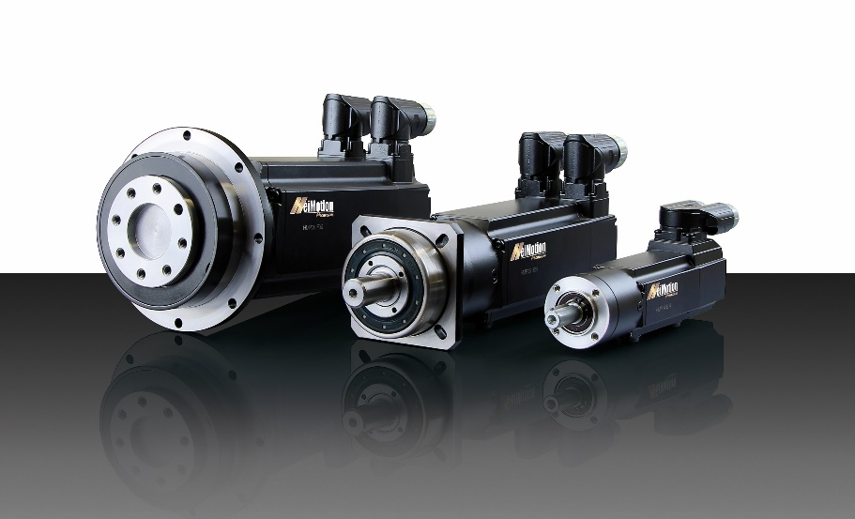
HeiMotion with planetary gears
HMPG – HeiMotion Premium Gear
Motor and gear as a system out of one hand – completely mounted, checked and painted
Applications – where its advantages can be used
Series - for higher batch quantities and customers defining a preferred range of gears and ratios
Ratios available:
1 stage: 1:1 – 10 : 1
2 stages: 9:1 – 64 :1
3 stages: 60:1 – 515 : 1 (only on request)
All versions integrated into the SAP configuration system
Only with E gears 15 Mio. Versions
Incl. P, H and F 30 Mio. Versions

Slide 18
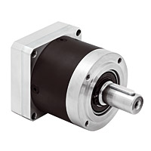
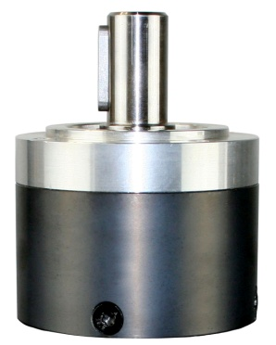
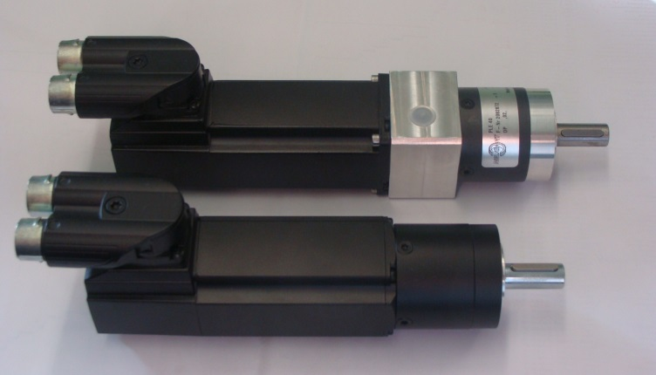
Advantages of direct attachment
Universal flange with clutch and additional bearing
Direct integration
(MDA – motor direct attachment)
Standard flange gear
low inertia (part reduction)
price reduction
higher efficiency
reduced space requirement
lower noise
lower weight
painted gear drive
Length reduction about 30 - 50mm
(according to the type)

Slide 19
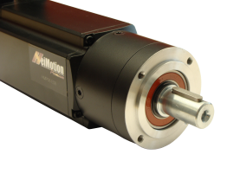
Variety of gear drive versions
The following planetary gears are available as MDA-version:
(All main components like motor-shaft, flange and sun wheel are the same)
Type:
PLE
PLPE
PLHE
PLFE
Features:
economy-series
lifetime lubrication
low noise
economy-series
high radial- und axial forces
high output torque
highest radial- und axial forces
low backlash
high output torque
economy-flange-series
low backlash
flexible adaption possibilities

Slide 20
Unique customer approach of
1
Modular platform concept
1 modular platform: HeiMotion
3 servo motor ranges: Compact, Premium, Dynamic
Variety of options (f. e. encoder and connector system)
=> Million solutions already in standard available
1
Modular platform concept
2
Customization of modules
Customization of standard modules to fit the clients individual needs
E.g. flanges, encoders and covers
Flexibility in addressing customer NEEDS
2
3
3
Customer-specific developments
Customer-specific developments
Application-driven developments based on specific customer requests
R&D efforts typically in strong relationship with customers
Customization of modules

Slide 21
USPs – basic factors
Continuous modular platform concept with 3 motor ranges (HMC, HMP, HMD) from 0.05 to 4.0 kW (15 kW middle 2017)
European design in asian sizes > compatible to SanyoDenki, Mitsubishi, Yaskawa and Panasonic
Incomparable high variance of encoder systems by a uniform mechanical connection >> encoders can be changed even after the purchase
Connector systems M23, Y-Tec and Twintus are standard
Rapid realization of customer-specific designs (mechanical and electrical) possible through an own coil production without additional charges
Specially designed holding brake without brake gap adjustment => Avoiding assembly errors
Protection class up to IP 65 in all motor sizes standard
Highest accuracy and synchronization
Small and compact design

Slide 22
USPs – performance factors
Finely graded and significantly reduced inertia by HMD
Low cogging torque by optimized magnet assembly < 1,5% cogging torque at HMD < 2,5% cogging torque at HMP
Speed up to 9,000 rpm as standard
UL isolation
KTY temperature measurement as standard
Connection and housing concept for maximum EMC claims with grounding protection of all wires
Highly precise planetary gear boxes directly mounted with a low rotational clearance
High power density by optimum shape of the winding heads > energy efficiency up to 94%

Slide 23
USPs – enthusiasm factors
Floating bearing set into a steel bushing to compensate tolerances and thermal expansion => to avoid wear and noise even at high temperatures => increased durability
Unique: Brake mounted at A-side to achieve an optimal power flow and zero effect on the bearing => high-precision positioning and no influence on the enocder
Larger ball bearing dimensions compared to competitive products => increased durability
Protection against damage and loss of magnets by fiberglass bandage
High surge voltage durability(HMP > 8 kV & HMD > 14 kV)
4-fold (HMP) and 2,5-fold (HMD) overload capacity of nominal values
Demagnetization only starting from 10-times overload
cURus recognition
Extremely low noise level at high speeds up to 9,000 rpm by noise optimized encoder systems

Slide 24
What sets us apart is…
Tailored concept solutions for customer´s needs are the focus
Decades of experience in various industries
High in-house manufacturing depth and closely strained supplier network
Deployment of latest development and manufacturing technologies
Broad range of services with the greatest variety of solutions
Excellent service(from consulting to commissioning)
Longterm and trustworthy partnerships
Strong, experienced project management
Consistently lived quality concept
Private tooling and prototyping
Excellent reliability

Slide 25
… the new way to solve drive solutions/demands!

